Slide 1
Banking on Devops
A wondrous and glorious journey

Slide 2
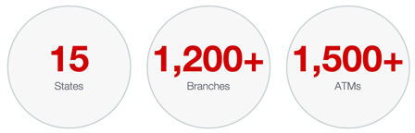
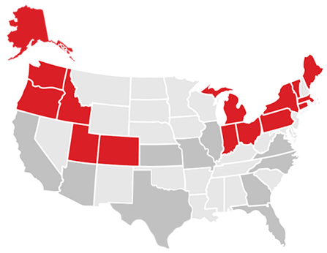


About Keybank
One of the Top 25 largest banks in US
Headquartered in Cleveland OH
$136 Billion in Assets
$5.8 Billion in Revenue
20,000+ Employees
2 Datacenters in US
8 consecutive Outstanding ratings for lending under the Community Reinvestment Act
4 times named a Best Place to Work for LGBT Equality by the HRC
Corporate Bank Business Units
Real Estate Capital
Treasury Management
Derivatives/Foreign Exchange
Investment Banking
Equipment Finance
Institutional Asset Services
Broker Dealer
Pacific Crest Research
Retail & Corporate Offices
Addtl. Corporate Offices

Slide 3
Admitting you have a problem
Complexity Grew Over Time thru Acquisition
Significant Outages with Poor Mean-Time-To-Resolution (MTTR)
Component Failover was Misunderstood
Traditional Silo’d IT Organization Drove a Lack of Communication, Finger Pointing, and Deficiency in Re-Usability
Quarterly Release Cycles
Manual Testing
Arduous ITIL Processes

Slide 4
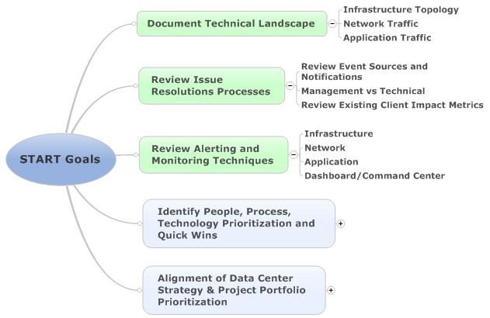
Executive direction
IT Senior Leadership Wanted to Understand the Complexity of our Solutions
Senior Technical Action Review Team (START)
Resources were Taken Out of Their Day Jobs To Deliver a Comprehensive Understanding of the End-To-End Technical Environment and Identify Root Causes For Critical Application Outages

Slide 5
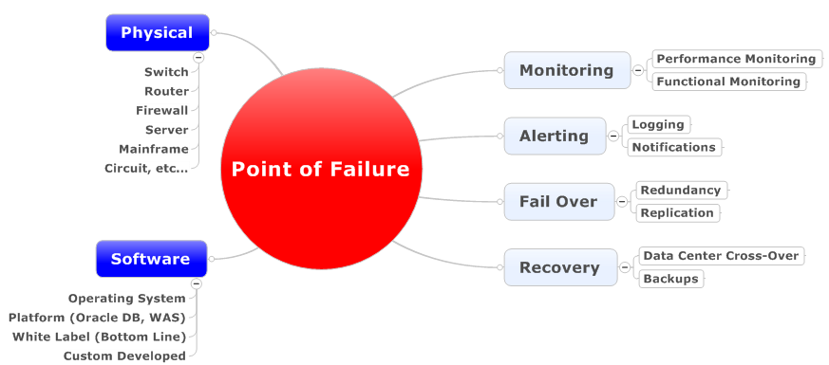

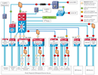
START Process defined
For Each Channel
1
Consolidate/Refresh Server, Network, and Solution Diagrams to a Channel Blueprint.
2
Review the Playbook for each Point of Failure

Slide 6
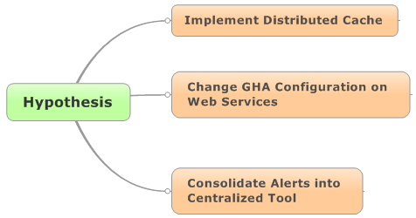
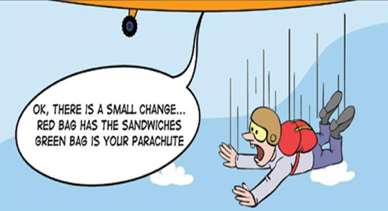
Start process cont.
For Each Channel
3
Complete research and construct Hypotheses
4
Review and test specific situations, document conclusions and Communicate results / recommended changes

Slide 7
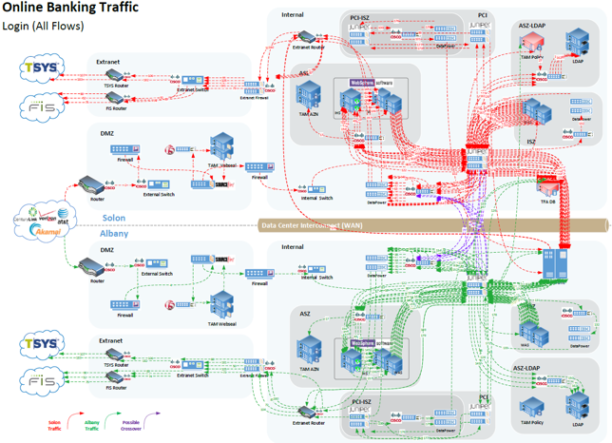
The outcome
Findings
Complexity (190 Network Hops on Login)
Lack of Standard Configurations
Lack of Automation
Silo’d Approach to Reliability Responsibilities
Exponential Growth of the Environment created Large Amounts of Technical Debt
Recommendations
Events/Alerting Modernization
EOC Enhancements
Network Re-Architecture
Developed Reference Architectures
*** DevOps ***

Slide 8

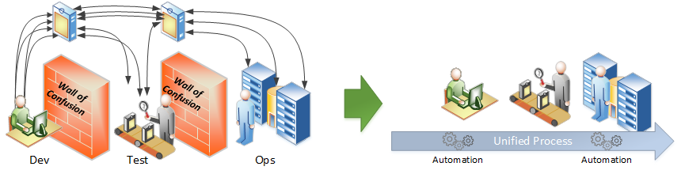


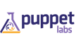
Elevator pitch
2.3 BN is the growth opportunity expected for the DevOps toolsets by 2015
88% of IT executives have already or planned to adopt DevOps
Shorten Delivery Time
Having an automated process in place allows our technology teams to safely make changes without lengthy release processes getting the business capabilities to our customers sooner.
Manual Weekly/Bi-Weekly QA Cycle to Automated Daily QA Cycle
85% Reduction in Production Release Cycles (Testing, Security, Release)
Greater Quality
Running tests several times a day identifies issues earlier and removing manual configuration brings a higher degree of stability to products going live.
Reduction in 30% of New Defects
Reduction in 50% of Deployment Failures
Increased Automation
Automating will optimize testing and infrastructure resources enabling Key to develop a lean delivery process.
40% Optimization of Release & Code Management
50% Optimization of Test Labor
20% Optimization of Infrastructure Engineering
12X the mean-time-to-recover and 2X the change success rate with DevOps
21% less time putting out fires and 33% more time improving infrastructure compared to traditional

Slide 9

Getting started
Focus Areas
C
Containers
T
Automated Testing
D
Continuous Delivery
C
Projects
T
Team
T
Change Agents
Angel Funded
D

Slide 10

tooling

Slide 11


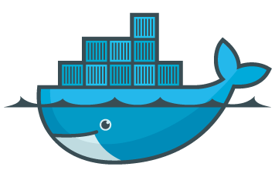




Containergeddon & Generation C
Install / Release
Configure
IBX
TFA
BPY
MBL
Security
Operations
Platform
• Daily Preview Builds
• Open Source Platforms
• 70+ Development Builds / Day
• Developer Self-Service
• No Patches & Upgrades Just Deployments
Jersey
Jersey
Test & Validate
Application
Dependencies
Java
Java
Patch
OS
OS
Upgrade
Guest
Guest
Hotfix

Slide 12



battleship for containergeddon
Reliability
Isolation
Rolling Deployments
Auto Scaling
Micro-Service Security
Kubernetes is an Open-Source Orchestration system for Docker Containers. It handles scheduling on to nodes into a compute cluster and actively manages workloads to ensure their state matches the users declared intentions. Using the concepts of labels and pods, it groups the containers which make up an application into logical units for easy management and discovery.
BORG Cluster Management

Slide 13
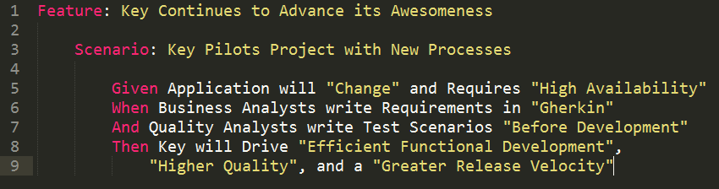
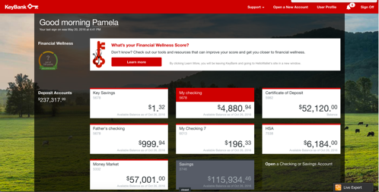


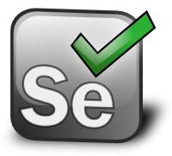
High velocity quality assurance
In an effort to achieve quality in a high velocity environment, unit testing, API testing, and automated regression testing is required; however, large enterprises typically are not starting with green field quality assurance teams so adapting the model and training cannot be an afterthought.
Streamline Delivery

Slide 14
Continuous delivery
• Updated roles and responsibilities that use data to drive accountability and re-usability
• Consistent and centralized lifecycle for Setup, Development, Testing, and Configuration
• Automation to deliver Insights, repeatable/testable processes, and stronger governance to release policies
• Maintainable and manageable release pipeline that can drive change quickly while enforcing quality thru test automation

Slide 15


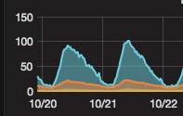

Goal progression
Consistent Release Process that Guarantees Versions are Deployed in a Dependable Automated Manner
Bank Acquisition Customer Day One
10
# of Production Releases to Respond to Customer Input in the first 4 days
Rolling Deployments allow Key to Deploy during Peak Business Hours without Affecting Actual Users
0
Legacy Test Automation
*Still Required Manual Testing
# of Defects Resulting in Production Releases
*Executed Every 5 Minutes
New Test Automation
During Highest Commit Phase Key Was Identifying 10 Defects / Day
Averages Roughly 5000 Tests Executing per Build
60% Defects Resolved within a Day
Valuable Dashboards that have assisted in identifying bottlenecks and anomalies that were invaluable in production and assisted are ability to achieve production
Open Source Software will assist Key from Costly Enterprise License Agreements. The New DevOps Application Platform is built off of Open Source Platforms and avoids any new Acquisition Costs and a fraction of the S&S Costs

Slide 16
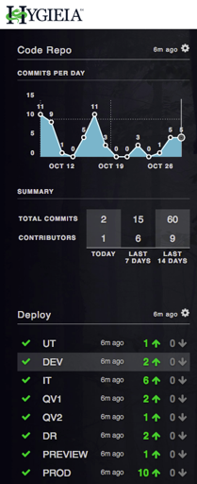
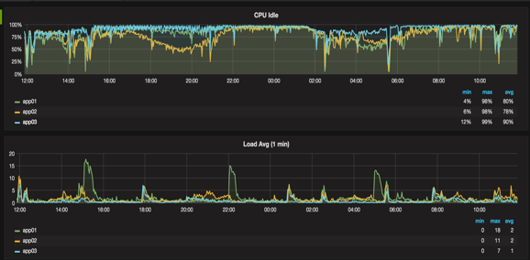
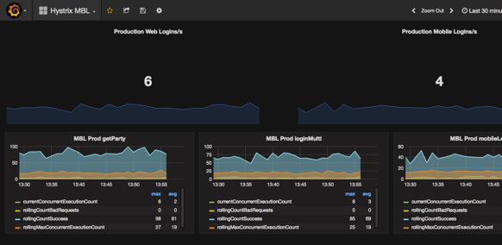
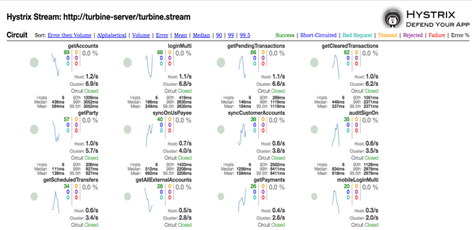
Employing and contributing to open source
We have implemented many open source projects that enable us to have data driven conversations with our development, delivery, and support teams.
Spotlight Dashboard:
Key built a Kubernetes Hygieia Plugin to Monitor Pod State and is working to Contribute to the Hygieia Project with other Plugins.

Slide 17
Biggest speed bumps
Policy & Process Adherence
Communication is critical, engaging ITIL, risk and audit early to get them comfortable. Rolling up the sleeves to knock down the next blocker. Expose the benefits (Traceability, Automated vs. Manual, etc…)
We are heavily invested in our ITIL processes as a financial services organization. It’s only compounded with regulations and compliance. Add to that risk, audit, and our internal security groups that want to be proactive with process to ensure the company’s safety.
Legacy Skillsets & Offshore Model
Moving to Similar Time Zones to keep constant communication. Mentoring / Training and review sessions early in the process. Swapping out resources was also required.
Implementation with an opposite time zones when results are instant loses value in some of the offshore models. This actually creates productivity issues especially in the automated testing space combined with new tools and skills required to complete work.
Still a big work in progress and scaling across the organization is a big task for next year. Injecting our DevOps Ninjas into specific teams as well as providing a learning center (similar to the Target DOJO model) are the plans to scale the practice.
Change Management for Existing Teams
The culture change was a big shock to some internal support teams inundated with backlog and current support. Development teams were held to higher accountability, infrastructure engineering continues to be skeptical, and middle management continues protecting resources.

